Slide 1
A GIFT OF FIRE
THIRD EDITION
SARA BAASE
CHAPTER 2: PRIVACY
Original Slides prepared by Cyndi Chie and Sarah Frye
Adapted by Enas Naffar for use in Computing Ethics course –Philadelphia university

Slide 2
WHAT WE WILL COVER
Privacy and Computer Technology
“Big Brother is Watching You”
Privacy Topics
Protecting Privacy
Communications
Original Slides prepared by Cyndi Chie and Sarah Frye
Adapted by Enas Naffar for use in Computing Ethics course –Philadelphia university

Slide 3
PRIVACY AND COMPUTER TECHNOLOGY
Key Aspects of Privacy:
Freedom from intrusion (being left alone)
Control of information about oneself
Freedom from surveillance (being tracked, followed, watched)
Original Slides prepared by Cyndi Chie and Sarah Frye
Adapted by Enas Naffar for use in Computing Ethics course –Philadelphia university

Slide 4
PRIVACY RISKS AND PRINCIPLES
Privacy threats come in several categories:
Intentional, institutional uses of personal information
Unauthorized use or release by “insiders”
Theft of information
Inadvertent leakage of information
Our own actions
Original Slides prepared by Cyndi Chie and Sarah Frye
Adapted by Enas Naffar for use in Computing Ethics course –Philadelphia university

Slide 5
PRIVACY AND COMPUTER TECHNOLOGY
New Technology, New Risks:
Government and private databases
Thousands of databases containing personal information about us.
Profiles of our personal information could be created easily.
Sophisticated tools for surveillance and data analysis
- Cameras, GPS, cell phones
Original Slides prepared by Cyndi Chie and Sarah Frye
Adapted by Enas Naffar for use in Computing Ethics course –Philadelphia university

Slide 6
PRIVACY AND COMPUTER TECHNOLOGY (CONT.)
Vulnerability of data
- Leaks of data happens, existence of data presents a risk.
Original Slides prepared by Cyndi Chie and Sarah Frye
Adapted by Enas Naffar for use in Computing Ethics course –Philadelphia university

Slide 7
PRIVACY RISKS AND PRINCIPLES
New Technology, New Risks – Examples:
Search query data
  Search engines collect many terabytes of data daily.
  Data is analyzed to target advertising and develop new services.
  Who gets to see this data? Why should we care?
51-52
Notes:
A terabyte is a trillion bytes.
Search query data can be subpoenaed in court.

Slide 8
PRIVACY RISKS AND PRINCIPLES
New Technology, New Risks – Examples:
Smartphones
  Location apps
  Data sometimes stored and sent without user’s knowledge
53-54
Notes:
Roughly half the apps in one test sent the smartphone’s ID number or location to other companies (in addition to the one that provided the app).
Various apps copy the user’s contact list to remote servers.
A major bank announced that its free mobile banking app inadvertently stored account numbers and security access codes in a hidden file on the user’s phone. Data in phones are vulnerable to loss, hacking, and misuse. This is a reminder that designers must regularly review and update security design decisions.

Slide 9
PRIVACY RISKS AND PRINCIPLES
New Technology, New Risks – Summary of Risks:
Anything we do in cyberspace is recorded.
Huge amounts of data are stored.
People are not aware of collection of data.
Software is complex.
Leaks happen.
55

Slide 10
PRIVACY RISKS AND PRINCIPLES
New Technology, New Risks – Summary of Risks
(cont.):
A collection of small items can provide a detailed picture.
Re-identification has become much easier due to the quantity of information and power of data search and analysis tools.
If information is on a public Web site, it is available to everyone.
55-56

Slide 11
PRIVACY RISKS AND PRINCIPLES
New Technology, New Risks – Summary of Risks
(cont.):
Information on the Internet seems to last forever.
Data collected for one purpose will find other uses.
Government can request sensitive personal data held by businesses or organizations.
We cannot directly protect information about ourselves. We depend upon businesses and organizations to protect it.
56

Slide 12
PRIVACY AND COMPUTER TECHNOLOGY (CONT.)
Terminology and principles for data collection and use:
Invisible information gathering
Collection of personal information about someone without the person’s knowledge
  Unauthorized software, Cookies, ISP providers
Secondary use
- Use of personal information for a purpose other than the one it was provided for .
Original Slides prepared by Cyndi Chie and Sarah Frye
Adapted by Enas Naffar for use in Computing Ethics course –Philadelphia university

Slide 13
Q:
RECALL AN EXAMPLE OF INVISIBLE INFORMATION GATHERING ABOUT YOU…

Slide 14
PRIVACY AND COMPUTER TECHNOLOGY (CONT.)
Terminology (cont.):
Secondary use:
1- Data mining
Searching and analyzing masses of data to find patterns and develop new information or knowledge
2- Computer matching
Combining and comparing information from different databases (using social security number, for example, to match records)
Original Slides prepared by Cyndi Chie and Sarah Frye
Adapted by Enas Naffar for use in Computing Ethics course –Philadelphia university

Slide 15
Privacy and Computer Technology (cont.)
Terminology (cont.):
Data mining - searching and analyzing masses of data to find patterns and develop new information or knowledge
Computer matching - combining and comparing information from different databases (using social security number, for example, to match records)
  D&D Matching
  VA Benefits
  Debate

Slide 16
Computer Matching
Combining and comparing information from more than one database. Some examples:
  Sharing of government agencies’ databases to detect fraud by recipients of government programs.
  Creating consumer dossiers from various business databases.

Slide 17
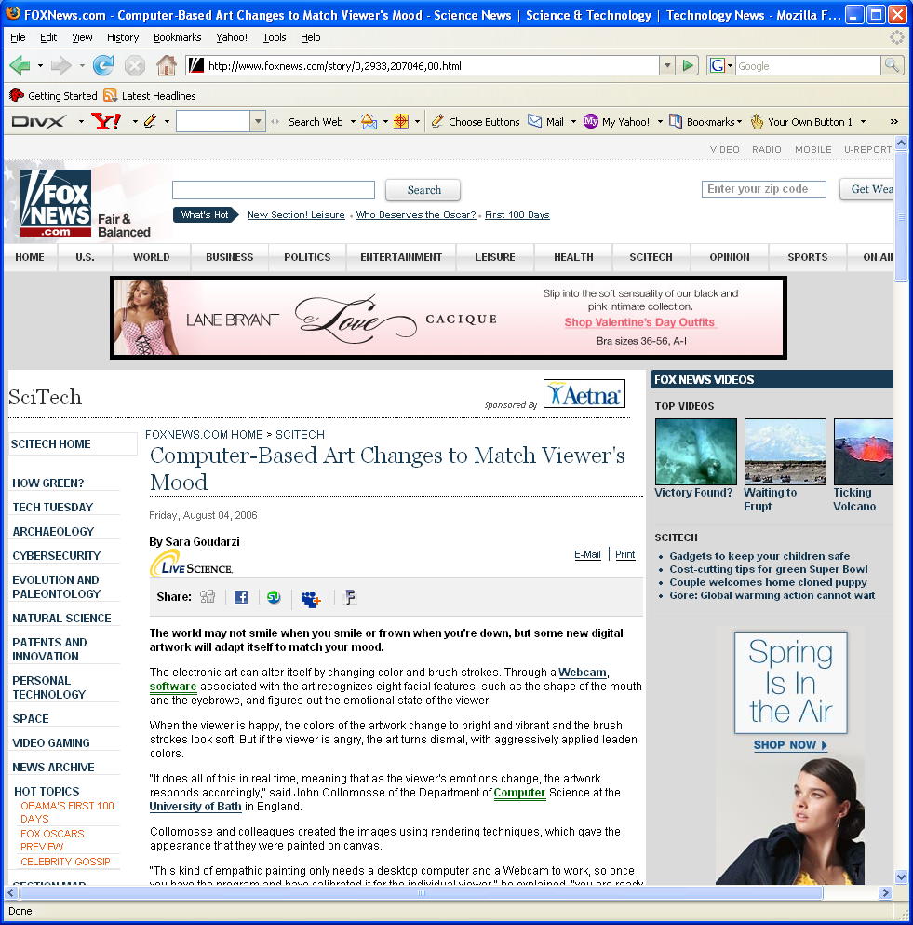
Computer Matching

Slide 18
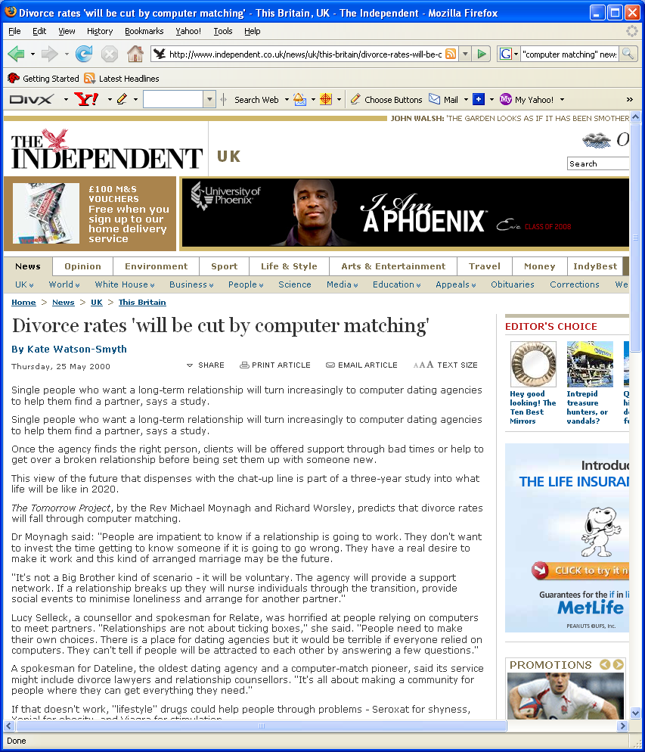

Computer Matching

Slide 19
PRIVACY AND COMPUTER TECHNOLOGY (CONT.)
Terminology (cont.):
3- Computer profiling
- Analyzing data in computer files to determine characteristics of people most likely to engage in certain behavior
Businesses find new consumers
- Government detects fraud and crime activities
Original Slides prepared by Cyndi Chie and Sarah Frye
Adapted by Enas Naffar for use in Computing Ethics course –Philadelphia university

Slide 20
Privacy and Computer Technology (cont.)
Profiling
  Using data in computer files to predict likely behaviors of people. Some examples:
    Businesses engage in profiling to determine consumer propensity toward a product or service.
    Government agencies use profiling to create descriptions of possible terrorists.

Slide 21
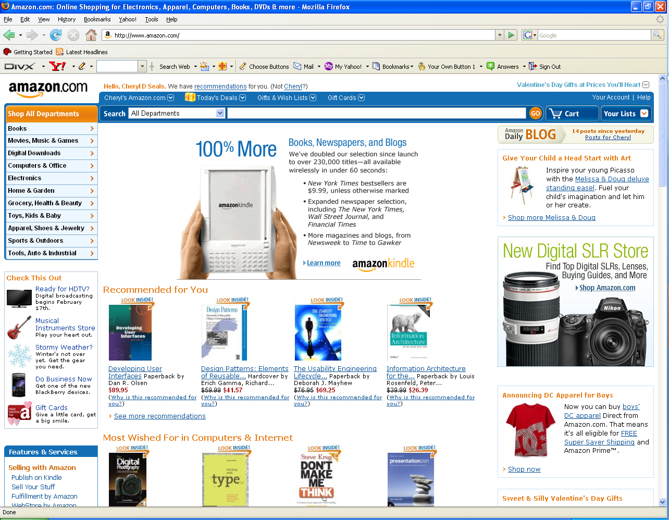
Amazon.com

Slide 22
PRIVACY AND COMPUTER TECHNOLOGY (CONT.)
Principles for Data Collection and Use:
Informed consent
Opt-in and opt-out policies
Fair Information Principles (or Practices)
Data retention
Original Slides prepared by Cyndi Chie and Sarah Frye
Adapted by Enas Naffar for use in Computing Ethics course –Philadelphia university

Slide 23
PRIVACY AND COMPUTER TECHNOLOGY (CONT.)
Informed consent
People should be informed about the data collection and use policies of a business or organization,
They can then decide whether or not to interact with that business or organization.
Original Slides prepared by Cyndi Chie and Sarah Frye
Adapted by Enas Naffar for use in Computing Ethics course –Philadelphia university

Slide 24
PRIVACY AND COMPUTER TECHNOLOGY (CONT.)
Opt-in and opt-out policies
To give people some control over secondary uses
Under opt-out policy, the organization can use one’s information for other purposes only if he explicitly inform the organization (ex. Signs a form) permitting the use.
Under opt-in policy, the collector of information may not use it for other purposes unless the consumer explicitly permits the use.
Original Slides prepared by Cyndi Chie and Sarah Frye
Adapted by Enas Naffar for use in Computing Ethics course –Philadelphia university

Slide 25
PRIVACY AND COMPUTER TECHNOLOGY
DISCUSSION QUESTIONS
Have you seen opt-in and opt-out choices? Where? How were they worded?
Were any of them deceptive?
What are some common elements of privacy policies you have read?
Original Slides prepared by Cyndi Chie and Sarah Frye
Adapted by Enas Naffar for use in Computing Ethics course –Philadelphia university
Notes:
If the class doesn't mention it, make sure to mention that online opt-in choices may be pre-checked and require you un-checking the box to avoid opting in.
Be sure to mention the "subject to change without notice" clause found in most privacy policies.

Slide 26
PRIVACY AND COMPUTER TECHNOLOGY (CONT.)
Fair Information Principles (or Practices)
  Inform about personally identifiable information
  Collect only data needed
  Offer opt-out from email, advertising, etc
  Stronger protection of sensitive data
  Keep data only as long as needed
  Maintain accuracy of data
  Policies for responding to law enforcement
  Protect security of data.
Original Slides prepared by Cyndi Chie and Sarah Frye
Adapted by Enas Naffar for use in Computing Ethics course –Philadelphia university

Slide 27
"Big Brother is Watching You" (cont.)
The Fourth Amendment, Expectation of Privacy and Surveillance Technologies(p66) :
Has technology strengthened or weakened the Fourth Amendment???
Weakening the Fourth Amendment
Supreme Court decisions and expectation of privacy
  Modern surveillance techniques are redefining expectation of privacy

Slide 28
"Big Brother is Watching You" (cont.)
The Fourth Amendment, Expectation of Privacy and Surveillance Technologies (cont.):
The USA Patriot Act and national security letters
  No court order or court oversight needed
  2003-2005 report found "widespread and serious misuse" of the FBIs national security letter authorities

Slide 29
"BIG BROTHER IS WATCHING YOU"
Databases:
Government agencies collect many types of information
Ask business to report about consumers
Buy personal information from sellers
Main publicized reason: data mining and computer matching to fight terrorism
Original Slides prepared by Cyndi Chie and Sarah Frye
Adapted by Enas Naffar for use in Computing Ethics course –Philadelphia university

Slide 30
"BIG BROTHER IS WATCHING YOU"
Databases:
Private information can be used to:
Arrest people
Jail people
Seize assets
Original Slides prepared by Cyndi Chie and Sarah Frye
Adapted by Enas Naffar for use in Computing Ethics course –Philadelphia university

Slide 31
"BIG BROTHER IS WATCHING YOU"
Databases:
Millions of crime suspects are searched in government databases
Shift from presumption of innocence to presumption of guilt
Computer software characterizes suspects
- Innocent people are sometimes subject to embarrassing searches and expensive investigations and to arrest and jail.

Slide 32
"Big Brother is Watching You"
Small Sampling of
Government Databases with Personal Information
What data does the government have about you?
Tax records
Medical records
Marriage and divorce records
Property ownership
Welfare records
School records
Motor vehicle records
Voter registration records
Books checked out of public libraries
People with permits to carry firearms
Applications for government grant and loan programs
Professional and trade licenses
Bankruptcy records
Arrest records
Notes:
Use the list in Fig. 2.2 (page 58) to start the conversation. Probe for what concerns the class may have about the data that is collected.

Slide 33
"BIG BROTHER IS WATCHING YOU" (CONT.)
Some constitution articles (laws) protect privacy.
Modern surveillance techniques are redefining expectation of privacy.
What privacy is included in those laws ?
Original Slides prepared by Cyndi Chie and Sarah Frye
Adapted by Enas Naffar for use in Computing Ethics course –Philadelphia university

Slide 34
"BIG BROTHER IS WATCHING YOU" (CONT.)
In some countries:
  No court order or court oversight needed to get one’s private information.
  2003-2005 report found "widespread and serious misuse" of the FBIs national security letter authorities.
Original Slides prepared by Cyndi Chie and Sarah Frye
Adapted by Enas Naffar for use in Computing Ethics course –Philadelphia university

Slide 35
"BIG BROTHER IS WATCHING YOU"
Two key problems arise from new technologies:
  Much of our personal information is no longer safe in our homes; it resides in huge databases outside our control.
  New technologies allow the government to search our homes without entering them and search our persons from a distance without our knowledge.

Slide 36
"BIG BROTHER IS WATCHING YOU" (CONT.)
Video Surveillance:
Security cameras in Shopping centers, malls, banks, etc.
Cameras alone raise some privacy issues.
When being combined with face recognition systems, they raise more privacy issues.
  Increased security
  Decreased privacy
Original Slides prepared by Cyndi Chie and Sarah Frye
Adapted by Enas Naffar for use in Computing Ethics course –Philadelphia university

Slide 37
"BIG BROTHER IS WATCHING YOU" (CONT.)
DISCUSSION QUESTIONS
What data does the government have about you?
Who has access to the data?
How is your data protected?
Original Slides prepared by Cyndi Chie and Sarah Frye
Adapted by Enas Naffar for use in Computing Ethics course –Philadelphia university
Notes:
Use the list in Fig. 2.2 (page 58) to start the conversation. Probe for what concerns the class may have about the data that is collected.

Slide 38
DIVERSE PRIVACY TOPICS
Marketing, Personalization and Consumer Dossiers:
Targeted and personalized marketing (business, political parties, etc)
  Paying for consumer information
  Examples
  Trading data to win prizes
  Targeting ads to users by scanning their emails! Like Gmail.
Original Slides prepared by Cyndi Chie and Sarah Frye
Adapted by Enas Naffar for use in Computing Ethics course –Philadelphia university

Slide 39
DIVERSE PRIVACY TOPICS
  Data firms and consumer profiles
  Companies (firms) that collect information about individuals
  These firms sell data to other companies for marketing purposes.
  Data mining is being used
  Credit records might be sold to different parties
Original Slides prepared by Cyndi Chie and Sarah Frye
Adapted by Enas Naffar for use in Computing Ethics course –Philadelphia university

Slide 40
DIVERSE PRIVACY TOPICS
Social Networks
What we do
  Post opinions, gossip, pictures, “away from home” status
What they do
  New services with unexpected privacy settings
75-77
Notes:
People trying to clean up their online personas before starting a job search find that it is hard to eliminate embarrassing material.
When Facebook began telling members about purchases their friends made, problems ranged from spoiling surprise gifts to embarrassing and worrisome disclosures. Should Facebook introduce such features turned “on” for everyone? Or should the company announce them and let members opt in with a click?

Slide 41
DIVERSE PRIVACY TOPICS (CONT.)
Location Tracking:
Global Positioning Systems (GPS) -computer or communication services that know exactly where a person is at a particular time
Cell phones and other devices are used for location tracking
Pros and cons
Original Slides prepared by Cyndi Chie and Sarah Frye
Adapted by Enas Naffar for use in Computing Ethics course –Philadelphia university

Slide 42
DIVERSE PRIVACY TOPICS (CONT.)
Stolen and Lost Data:
Hackers
Physical theft (laptops, thumb-drives, etc.)
Requesting information under false pretenses
Bribery of employees who have access
Original Slides prepared by Cyndi Chie and Sarah Frye
Adapted by Enas Naffar for use in Computing Ethics course –Philadelphia university
Notes:
Except for hackers, these are not new to computer technology. Before computers, files were stolen, receipts were stolen, information was requested under false pretenses and employees were bribed. But, with computers, the extent and impact have grown.

Slide 43
DIVERSE PRIVACY TOPICS (CONT.)
What We Do Ourselves:
Some people do not know or understand enough how the web works in order to make good decisions about what to put there.
Some people do not think carefully.
People often want a lot of information about others but do not want others to have access to the same kind of information about themselves.
Original Slides prepared by Cyndi Chie and Sarah Frye
Adapted by Enas Naffar for use in Computing Ethics course –Philadelphia university

Slide 44
DIVERSE PRIVACY TOPICS (CONT.)
What We Do Ourselves:
Our cell phone and email messages reside on computers outside our home or office.
We have no direct control over such files.
There have been many incidents of exposure of emails for politicians, businessmen, etc.
Original Slides prepared by Cyndi Chie and Sarah Frye
Adapted by Enas Naffar for use in Computing Ethics course –Philadelphia university

Slide 45
DIVERSE PRIVACY TOPICS (CONT.)
What We Do Ourselves:
Personal information in blogs and online profiles
Pictures of ourselves and our families
File sharing and storing
Is privacy old-fashioned?
  Young people put less value on privacy than previous generations.
  May not understand the risks.
Original Slides prepared by Cyndi Chie and Sarah Frye
Adapted by Enas Naffar for use in Computing Ethics course –Philadelphia university

Slide 46
DIVERSE PRIVACY TOPICS (CONT.)
Public Records: Access vs. Privacy:
Public Records - records available to general public (bankruptcy, property, and arrest records, salaries of government employees, etc.)
Identity theft can arise when public records are accessed
How should we control access to sensitive public records?
Original Slides prepared by Cyndi Chie and Sarah Frye
Adapted by Enas Naffar for use in Computing Ethics course –Philadelphia university

Slide 47
DIVERSE PRIVACY TOPICS (CONT.)
Children ( privacy and safety)
The Internet
  Not able to make decisions on when to provide information
  Vulnerable to online predators
Parental monitoring
  Software to monitor Web usage
  Web cams to monitor children while parents are at work
  GPS tracking via cell phones or RFID
Original Slides prepared by Cyndi Chie and Sarah Frye
Adapted by Enas Naffar for use in Computing Ethics course –Philadelphia university

Slide 48
DIVERSE PRIVACY TOPICS (CONT.)
Children ( privacy and safety)
At what age does web monitoring become an invasion of the child’s privacy?
Should parents tell children about the tracking devices and services they are using?
Informed consent is a basic principle for adults. At what age does it apply to children?
Will intense tracking and monitoring slow the development of a child’s responsible independence?
Will parents rely more on gadgets than on talking to their children?
Original Slides prepared by Cyndi Chie and Sarah Frye
Adapted by Enas Naffar for use in Computing Ethics course –Philadelphia university

Slide 49
DIVERSE PRIVACY TOPICS
DISCUSSION QUESTIONS
Is there information that you have posted to the Web that you later removed? Why did you remove it? Were there consequences to posting the information?
Have you seen information that others have posted about themselves that you would not reveal about yourself?
Original Slides prepared by Cyndi Chie and Sarah Frye
Adapted by Enas Naffar for use in Computing Ethics course –Philadelphia university

Slide 50
Diverse Privacy Topics (cont.)
National ID System:
Social Security Numbers
  Too widely used
  Easy to falsify

Slide 51
Diverse Privacy Topics (cont.)
National ID System (Cont.):
A new national ID system - Pros
  would require the card
  harder to forge
  have to carry only one card
A new national ID system - Cons
  Threat to freedom and privacy
  Increased potential for abuse

Slide 52
Diverse Privacy Topics
Most folks have figured out by now you can’t do anything on the Web without leaving a record. - Holman W. Jenkins Jr., 2000
Most tech savvy folks
Many companies have work to enhance privacy for customers with Encryption
Cryptography is the art and science of hiding data in plain sight – Larry Loen
Hacking?
Web site operators pay thousands and sometimes millions for privacy audits.
Checking for leaks of information, review of company’s privacy policy and its compliance with policy
Truste

Slide 53
Diverse Privacy Topics (cont.)
Children:
Logging Activity on Internet
Cell phone enable parents to check child’s physical location
Devices in car tell parents where teens are and how FAST they are driving
RFID in shoes & Clothes

Slide 54
Diverse Privacy Topics (cont.)
Children:
The Internet
  Not able to make decisions on when to provide information
  Vulnerable to online predators
Parental monitoring
  Software to monitor Web usage
  Web cams to monitor children while parents are at work
  GPS tracking via cell phones or RFID

Slide 55
Diverse Privacy Topics
Discussion Questions
Is there information that you have posted to the Web that you later removed? Why did you remove it? Were there consequences to posting the information?
Have you seen information that others have posted about themselves that you would not reveal about yourself?

Slide 56
Privacy and Computer Technology
Discussion Questions
What is the impact of GPS-equipped children's’ wrist watches?
What is the impact of cell phones that provide tracking information to parents?
Is it legal for someone to search your computer?
Is it legal for someone to read your email?
Notes:
If the class doesn't mention it, make sure to mention that online opt-in choices may be pre-checked and require you un-checking the box to avoid opting in.
Be sure to mention the "subject to change without notice" clause found in most privacy policies.

Slide 57
PROTECTING PRIVACY
Technology and Markets:
Awareness:
Most people have figured out now you can’t do anything on the web without leaving a record.
We can decide to what extent we wish to use privacy-protecting tools.
We can be more careful about the information we give out, and the privacy policies of sites we use or visit.
Original Slides prepared by Cyndi Chie and Sarah Frye
Adapted by Enas Naffar for use in Computing Ethics course –Philadelphia university

Slide 58
PROTECTING PRIVACY
Technology and Markets:
Privacy-enhancing technologies for consumers
New applications of technology often can solve problems that arise as side effects of technology.
Example: cookie disablers, blocking pop-up ads, scanning PCs for spyware, etc.
Using usernames and passwords for Blogs visitors (family , friends, etc.).
Original Slides prepared by Cyndi Chie and Sarah Frye
Adapted by Enas Naffar for use in Computing Ethics course –Philadelphia university

Slide 59
PROTECTING PRIVACY
Technology and Markets:
Encryption
Information sent to and from websites can be intercepted.
Someone who steals a computer or hacks into it can view files on it .
Encryption is a technology that transforms data into a form that that is meaningless to anyone who might intercept or view it.
Original Slides prepared by Cyndi Chie and Sarah Frye
Adapted by Enas Naffar for use in Computing Ethics course –Philadelphia university

Slide 60
PROTECTING PRIVACY
Technology and Markets:
Encryption
Encryption generally includes a coding scheme, or cryptography algorithm, and specific sequences of characters (digits or letters).
Public-key cryptography: An encryption scheme, where two related keys are used.
- A key to encrypt messages.
- A key to decrypt messages.
Original Slides prepared by Cyndi Chie and Sarah Frye
Adapted by Enas Naffar for use in Computing Ethics course –Philadelphia university

Slide 61
PROTECTING PRIVACY
Technology and Markets:
Business tools and policies for protecting privacy
Well- designed database.
Using privacy audits to check for leaks of information, review the company's privacy policy , etc.
Some large companies like IBM and Microsoft, use their economic influence to improve consumer privacy on the web, by removing ads from their web sites.
Original Slides prepared by Cyndi Chie and Sarah Frye
Adapted by Enas Naffar for use in Computing Ethics course –Philadelphia university

Slide 62
PROTECTING PRIVACY (CONT.)
Rights and laws:
Theories
  Warren and Brandeis: The inviolate personality
  Warren and Brandeis criticized newspapers especially for the gossip columns.
  People have the right to prohibit publications of facts (and photos) about themselves.
  Libel, slander and defamation laws protect us when someone spreads false and damaging rumors about us. But they do not apply to true personal information.
  Privacy is distinct and needs its own protection.
Original Slides prepared by Cyndi Chie and Sarah Frye
Adapted by Enas Naffar for use in Computing Ethics course –Philadelphia university

Slide 63
PROTECTING PRIVACY (CONT.)
Rights and laws:
Theories
  Thomson: Is there a right to privacy?
  Thomson argues the opposite point f view.
  There is no violation of privacy without violation of some other right, such as the right to control our property or our person, the right to be free from violent attacks, the right to form contracts(and expect them to be enforced).
Original Slides prepared by Cyndi Chie and Sarah Frye
Adapted by Enas Naffar for use in Computing Ethics course –Philadelphia university

Slide 64
PROTECTING PRIVACY (CONT.)
Rights and laws:
Theories
Criticism of both theories ?
Original Slides prepared by Cyndi Chie and Sarah Frye
Adapted by Enas Naffar for use in Computing Ethics course –Philadelphia university

Slide 65
PROTECTING PRIVACY (CONT.)
Rights and laws:
Applying the theories:
Many court decisions since Warren and Brandeis article, have taken their point of view.
A person may win a case if someone published his/her consumer profile.
Warren and Brandeis (and court decisions) allow disclosure of personal information to people who have an interest in it.
An important aspect: consent.
Original Slides prepared by Cyndi Chie and Sarah Frye
Adapted by Enas Naffar for use in Computing Ethics course –Philadelphia university

Slide 66
PROTECTING PRIVACY (CONT.)
Rights and laws:
Transactions
Privacy includes control of information about oneself.
How to apply privacy notions to transactions, Which involve more than one person?
Original Slides prepared by Cyndi Chie and Sarah Frye
Adapted by Enas Naffar for use in Computing Ethics course –Philadelphia university

Slide 67
PROTECTING PRIVACY (CONT.)
Rights and laws:
Ownership of personal data
People should be given property rights in information about themselves.
But some activities and transactions involve at least two people, each of whom would have claims to own the information about the activity.
Can we own our profiles (collection of data describing our activities, purchase, interests, etc.) ?
- We cannot own the fact that our eyes have a certain color !
Original Slides prepared by Cyndi Chie and Sarah Frye
Adapted by Enas Naffar for use in Computing Ethics course –Philadelphia university

Slide 68
PROTECTING PRIVACY (CONT.)
Rights and laws:
Regulation
Technical tools for privacy protection, market mechanisms, and business policies are not perfect.
Regulation is not perfect either.
Some Regulations may be so expensive and difficult to apply.
Example: Health Insurance Portability and Accountability Act (HIPAA)
Original Slides prepared by Cyndi Chie and Sarah Frye
Adapted by Enas Naffar for use in Computing Ethics course –Philadelphia university

Slide 69
PROTECTING PRIVACY (CONT.)
Rights and laws: Contrasting Viewpoints:
Free Market View
  Freedom of consumers to make voluntary agreements
  Diversity of individual tastes and values
  Response of the market to consumer preferences
  Usefulness of contracts
  Flaws of regulatory solutions
Original Slides prepared by Cyndi Chie and Sarah Frye
Adapted by Enas Naffar for use in Computing Ethics course –Philadelphia university

Slide 70
PROTECTING PRIVACY (CONT.)
Rights and laws: Contrasting Viewpoints (cont.):
Consumer Protection View
  Uses of personal information
  Costly and disruptive results of errors in databases
  Ease with which personal information leaks out
  Consumers need protection from their own lack of knowledge, judgment, or interest
Original Slides prepared by Cyndi Chie and Sarah Frye
Adapted by Enas Naffar for use in Computing Ethics course –Philadelphia university

Slide 71
PROTECTING PRIVACY (CONT.)
Privacy Regulations in the European Union (EU):
Data Protection Directive
  More strict than U.S. regulations
  Abuses still occur
  Puts requirements on businesses outside the EU
Original Slides prepared by Cyndi Chie and Sarah Frye
Adapted by Enas Naffar for use in Computing Ethics course –Philadelphia university

Slide 72
PROTECTING PRIVACY
DISCUSSION QUESTION
How would the free-market view and the consumer protection view differ on errors in Credit Bureau databases?
Who is the consumer in this situation?
Original Slides prepared by Cyndi Chie and Sarah Frye
Adapted by Enas Naffar for use in Computing Ethics course –Philadelphia university

Slide 73
COMMUNICATION
Wiretapping and E-mail Protection:
Telephone
  1934 Communications Act prohibited interception of messages
  1968 Omnibus Crime Control and Safe Streets Act allowed wiretapping and electronic surveillance by law-enforcement (with court order)
E-mail and other new communications
  Electronic Communications Privacy Act of 1986 (ECPA) extended the 1968 wiretapping laws to include electronic communications, restricts government access to e-mail
Original Slides prepared by Cyndi Chie and Sarah Frye
Adapted by Enas Naffar for use in Computing Ethics course –Philadelphia university
Notes:
The meaning of pen register has changed over time. It originally referred to a device that recorded the numbers called from a phone. Now it also refers to logs phone companies keep of all numbers called, including time and duration.

Slide 74
COMMUNICATION (CONT.)
Designing Communications Systems for Interception:
Communications Assistance for Law Enforcement Act of 1994 (CALEA)
  Telecommunications equipment must be designed to ensure government can intercept telephone calls
  Rules and requirements written by Federal Communications Commission (FCC)
Original Slides prepared by Cyndi Chie and Sarah Frye
Adapted by Enas Naffar for use in Computing Ethics course –Philadelphia university

Slide 75
COMMUNICATION (CONT.)
Secret Intelligence Gathering:
The National Security Agency (NSA)
  Foreign Intelligence Surveillance Act (FISA) established oversight rules for the NSA
Secret access to communications records
Original Slides prepared by Cyndi Chie and Sarah Frye
Adapted by Enas Naffar for use in Computing Ethics course –Philadelphia university

Slide 76
COMMUNICATION (CONT.)
Encryption Policy:
Government ban on export of strong encryption software in the 1990s (removed in 2000)
Original Slides prepared by Cyndi Chie and Sarah Frye
Adapted by Enas Naffar for use in Computing Ethics course –Philadelphia university

Slide 77
COMMUNICATION
DISCUSSION QUESTIONS
What types of communication exist today that did not exist in 1968 when wiretapping was finally approved for law-enforcement agencies?
What type of electronic communications do you use on a regular basis?
Original Slides prepared by Cyndi Chie and Sarah Frye
Adapted by Enas Naffar for use in Computing Ethics course –Philadelphia university

